Slide 1

CCPS 506
Comparative Programming Languages
Fall 2019
Lecture 3: Functional paradigm, Elixir intro

Slide 2

Course Administration
We’re done with Smalltalk (for now)
You will of course be tested on it on the midterm and the final.
Midterm is on October 19, will cover Smalltalk, Elixir, and related concepts.

Slide 3
Course Administration
Assignment description for Smalltalk is posted
If you liked Smalltalk, you can start working on the Smalltalk version.
Eventually (after reading week) I will post test cases for your assignments.
This way you can verify that your code is correct for simple cases

Slide 4

Any Questions?

Slide 5
Let’s Get Started!

Slide 6
Imperative Paradigm
From Week 1
Imperative paradigm uses statements to change a program’s state.
The programmer specifies an explicit sequence of steps for the program to follow.
Adding procedures/functions/subroutines can improve scalability.
Code can be made more readable, less duplication, easier to reuse.
Principle of modularity – separate program functionality into independent, interchangeable modules.

Slide 7
Why Imperative?
From Week 1
Recipes, checklists, IKEA instructions, etc. are all familiar concepts.
These things are not computer programs, but are similar in style to imperative programming.
Understanding imperative programming is thus less of a conceptual leap for the novice programmer.

Slide 8

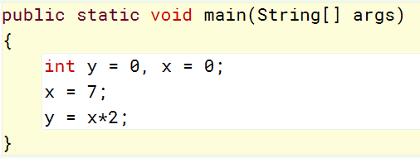
Why Imperative?
From Week 1
Machine code is imperative, and nearly all computer hardware is designed to execute machine code.
From this low level perspective, “state” can be described in terms of memory locations and machine instructions.
From a high level language perspective, state is described in terms of variables and more complex statements
In either case, the paradigm is the same.

Slide 9

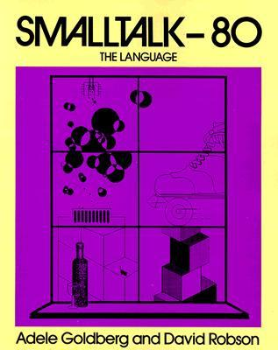

Alternatives?
Two widely used paradigms:
Functional Programming:
Avoid changing state, avoid mutable data
Declarative rather than imperative
Tell the program where to go, not how to get there.
Object Oriented Programming:
“Pure” OO languages treat even primitives and operators as objects
Java/C++ and others support OOP to greater or lesser degrees.

Slide 10
Moving on…

Slide 11
Today:
Functional programming paradigm
The Erlang VM
Intro to Elixir programming language
Basic types, strings, lists, tuples
Named and anonymous functions

Slide 12
Functional Programming

Slide 13
Declarative VS Imperative
Declarative programming paradigm:
Style of building and structuring computer programs.
Functional programming languages are characterized by a declarative style.
Express the logic of a computation rather than its control flow.
?
The order in which individual statements, instructions or function calls of an imperative program are executed or evaluated.
Emphasis on explicit control flow separates imperative languages from declarative languages.

Slide 14
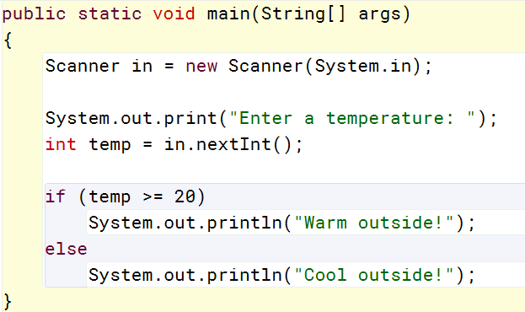
Control Flow
Determined using control structures in imperative languages.

Slide 15
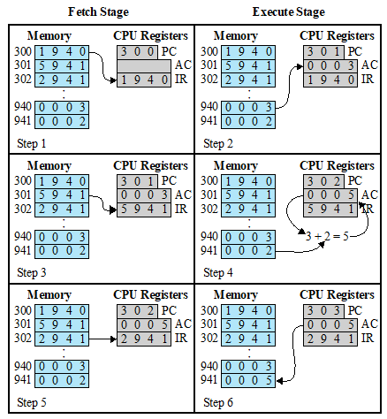
C/CPS 590 Example
At the machine instruction level, control flow typically works by altering the program counter.
Program counter tells the OS which instruction to fetch next.

Slide 16
Declarative VS Imperative
Imperative languages implement algorithms as a sequence of explicit steps (statements, control flow)
Declarative language syntax describes the logic of an algorithm
The declarative paradigm allows developers to worry about the what, not the how.
The how is left up to the language’s implementation (interpreter/compiler)

Slide 17
Always Remember!
Machine code is imperative.
Functional programs compile into machine code, just like imperative ones.
The distinction is in what the programmer is required to think about, and what the language hides behind the scenes.

Slide 18

Declarative VS Imperative
The actual, practical difference between these two paradigms can be very hard to grasp.
How can a programming language not have flow control?
What makes a language declarative? The fact that it’s not imperative.

Slide 19
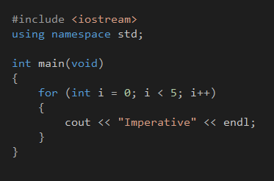
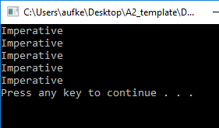
Faking it in C++
This C++ code is imperative
We use a control structure (for loop) to tell the program to iterate.
Even specify how this iteration is done.
Initialization, condition, update

Slide 20
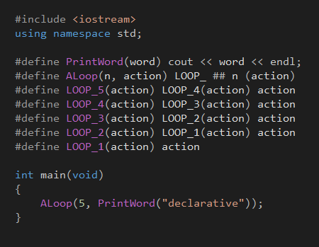
Faking it in C++
Simulate declarative programming using preprocessor directives.
Directives here are basically a list of substitutions
Assume that this is done by the programming language behind the scenes.

Slide 21
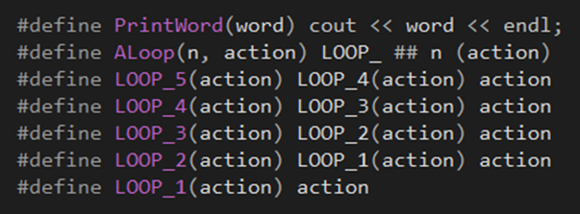
Faking it in C++
Directives here are basically a list of substitutions
ALoop(5, PrintWord("declarative"));

Slide 22
Faking it in C++
Directives here are basically a list of substitutions
action
ALoop(5, PrintWord("declarative"));
cout << word << endl;
LOOP_5 (action)
LOOP_5 (PrintWord("declarative"))
LOOP_5 (cout << word << endl;)

Slide 23
Faking it in C++
Directives here are basically a list of substitutions
action
ALoop(5, PrintWord("declarative"));
cout << word << endl;
LOOP_5 (action)
LOOP_4 (action) action
LOOP_3 (action) action action
LOOP_2 (action) action action action
LOOP_1 (action) action action action action
action action action action action

Slide 24
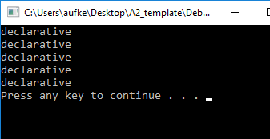
Faking it in C++
Imagine this was all done behind the scenes by the implementation of the programming language

Slide 25
Declarative VS Imperative
Imperative:
Programmer specifies control flow
Each loop iteration explicitly defined
for (int i = 0; i < 5; i++)
{
cout << "Imperative" << endl;
}
Declarative (C++ fakery):
Programmer says what they want
Nevermind how it’s done
ALoop(5, PrintWord("declarative"));

Slide 26
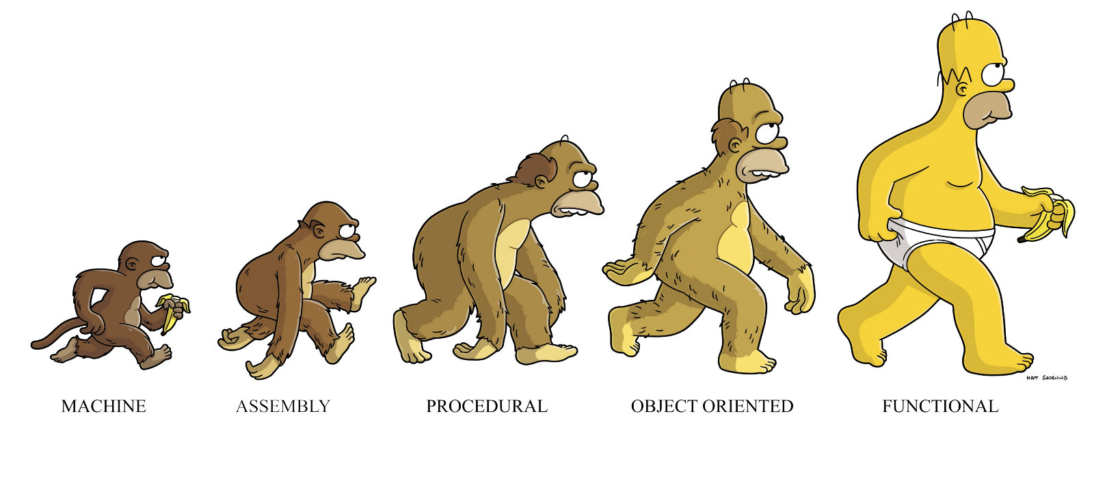
Functional Programming
Depends what you’re doing, depends who you ask…

Slide 27
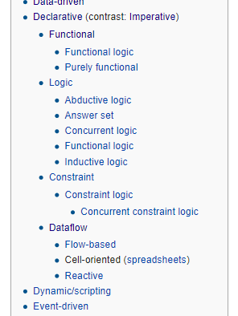
Functional Programming
Functional programming languages are characterized by a declarative style.
Functional are not the only declarative languages:

Slide 28
Always Remember
The line between imperative and functional programming is grey.
Code can be written in a functional style using a language not specifically designed for functional programming.
Some languages are designed to be functional, but still contain imperative elements.

Slide 29
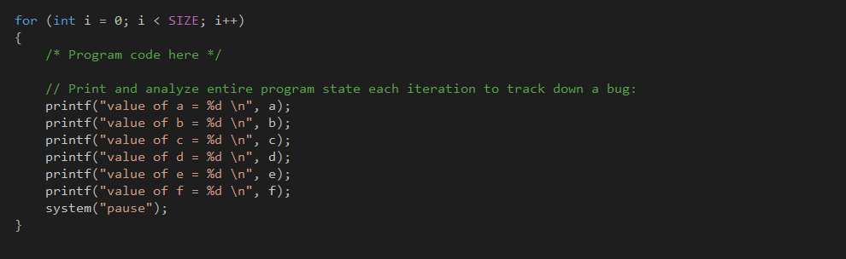
Functional Programming
Functional programming languages are characterized by a declarative style.
Avoids changing global state, no state to reason about.
No side effects!

Slide 30
Side Effects?
Another common definition of a declarative language:
“Any programming language that lacks side effects”
A function can be said to have a side effect if it has an observable interaction with the outside world aside from returning a value.
Modify global variable
Raise an exception
Write data to display or file

Slide 31
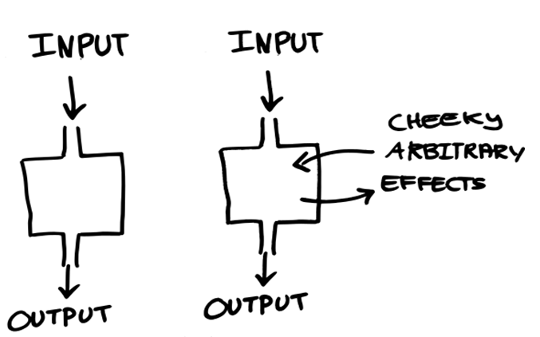
Side Effects
A function can be said to have a side effect if it has an observable interaction with the outside world aside from returning a value.

Slide 32
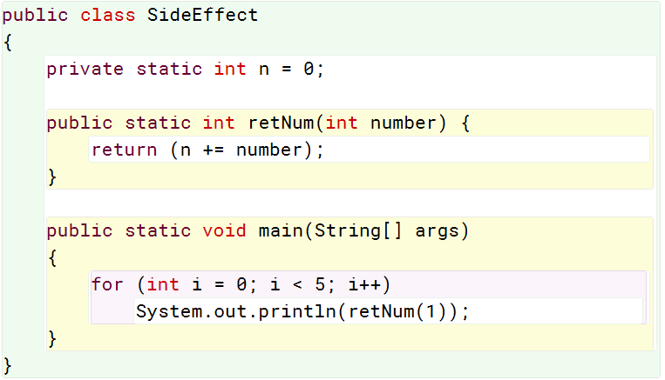
Side Effects
A function’s output can depend on history (or current state):
Call the same function, with the same argument, 5 times.
Different result each time.
Common in imperative languages.
Rarely used in functional languages.

Slide 33
Side Effects
Computation is accomplished primarily by evaluating mathematical functions and returning a result.
The output of a function depends solely on the input arguments
No side effects, no dependence on global or local state.
This makes it much easier to predict the behavior of a program
Primary motivation for developing functional programming
With no state to be concerned of, parallel processing becomes much easier. No race conditions!
Functions can be spawned as separate processes

Slide 34
Recursion
Flow control accomplished with functions calls.
Much lower focus on loop/if-else/case constructs.
Collections are operated upon using recursion.
Specifically, tail recursion. Tail recursion can be recognized and optimized by the compiler into the same machine code as iteration.

Slide 35
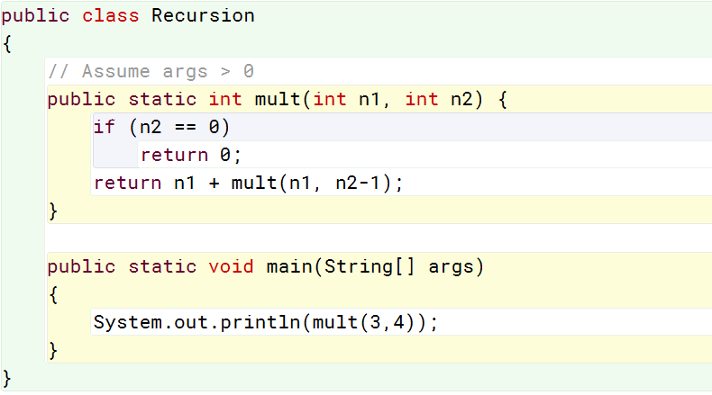
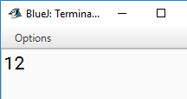
Recursion
mult(3, 4)
3+mult(3, 3)
3+(3+mult(3, 2))
3+(3+(3+mult(3, 1)))
3+(3+(3+(3+mult(3, 0))))
3+(3+(3+(3+0)))
12

Slide 36
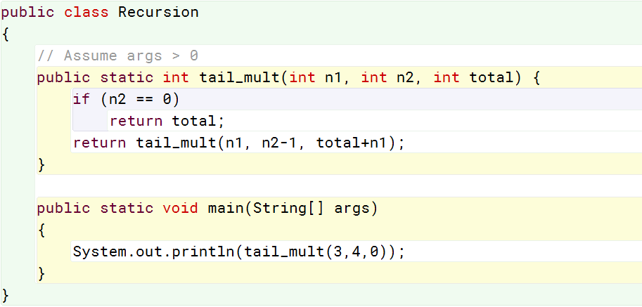
Tail Recursion
tail_mult(3, 4, 0)
tail_mult(3, 3, 3)
tail_mult(3, 2, 6)
tail_mult(3, 1, 9)
tail_mult(3, 0, 12)
12

Slide 37
Tail Recursion
mult(3, 4)
3 + mult(3, 3)
3 + (3 + mult(3, 2))
3 + (3 + (3 + mult(3, 1)))
3 + (3 + (3 + (3 + mult(3, 0))))
3 + (3 + (3 + (3 + 0)))
12
tail_mult(3, 4, 0)
tail_mult(3, 3, 3)
tail_mult(3, 2, 6)
tail_mult(3, 1, 9)
tail_mult(3, 0, 12)
12
Here, total is updated each call. This version looks a lot more like iteration. Optimizable.
Every recursive call must complete before we even begin adding values

Slide 38
Functional-Specific Concepts
Things that are generally foreign to imperative programming:
First class functions and higher order functions:
Functions that return functions or accept them as arguments (mathematical)
In calculus, differential operator. Derivative of function is a function.
“First class” describes programming language entities that have no restriction on their use.
I.e., first class functions can appear anywhere in the program that other first class entities (such as numbers) can.
Functions as arguments, return values, etc.

Slide 39
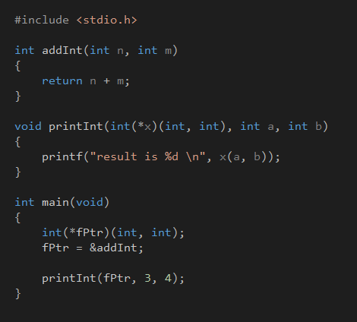
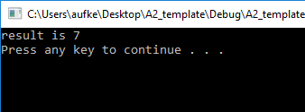
Always Remember…
The line between imperative and functional programming is grey.
C supports passing functions as arguments via function pointers.

Slide 40
Functional-Specific Concepts
Things that are generally foreign to imperative programming:
Pure Functions: Functions that have no side effects.
This results in several useful properties
If the return value of a pure function is not used, the function can be safely removed.
One to one mapping between function input and output.
Sometimes called referential transparency
If two pure functions do not have a data dependency, their ordering is irrelevant and they can be parallelized (thread-safe)

Slide 41
Quick Note
In practice it’s unreasonable to have a programming language containing only pure functions.
This would preclude things like file I/O and user input.
Common to have a pure function “core” surrounded by impure functions that interact with the outside world
Depends on the language.
Pure functions can be written in any language, but functional languages enforce them.

Slide 42
Functional-Specific Concepts
Things that are generally foreign to imperative programming:
Strict (eager) VS. non-strict (lazy) evaluation:
Strict: Always evaluate function arguments before invoking the function.
Lazy: Evaluates arguments if their value is required to invoke the function.
print length( [2+1, 3*2, 1/0, 5-4] );
Fails under strict evaluation, can’t divide by zero.
Under lazy evaluation we get the correct value of 4. We don’t need to know the actual values of the array elements to know how many there are.

Slide 43
Functional Programming Advantages
Easier to reason about pure functions:
If the function is internally consistent, it’s always correct.
No tracking down global variables, tracing pointers/references, etc.

Slide 44
Functional Programming Advantages
Parallel programming is easier:
No side effects, functions can be spawned as processes.
There is no state to be shared between different threads.
No need for semaphores (or similar) if you don’t have side effects!
Pure functions never access or modify things outside their scope
No such thing as a race condition when values are immutable.

Slide 45
Functional Programming Advantages
Programs are easier to understand:
for (int i = 0; i < 5; i++)
{
cout << "Imperative" << endl;
}
Allocate space for variable i
Initialize i to 0
Iterate as long as i is less than 5
Increment i after each iteration
ALoop(5, PrintWord("declarative"));
Do a thing 5 times

Slide 46
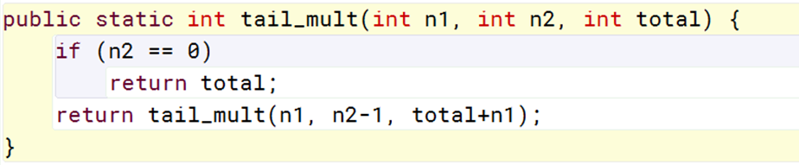
Downsides?
Recursion can cause memory use to explode:
Iterating over a list with 1000 items requires 1000 recursive calls.
Stack size explodes
Tail recursion mitigates this as we saw, but using tail recursion can often require inelegant code gymnastics.

Slide 47
Downsides?
Recursion can cause memory use to explode:
Iterating over a list with 1000 items requires 1000 recursive calls.
Stack size explodes
Tail recursion mitigates this as we saw, but using tail recursion can often require inelegant code gymnastics.
No assignment statements, data is immutable:
Performing actions requires allocating new memory.
Remember strings in Java – Changing the value of a string actually creates a new string object with the new value.
Garbage collection very important!

Slide 48
Downsides?
Performance:
Functional languages will typically perform worse than imperative languages when:
Computation is strictly sequential (CPU)
Computation is uniformly parallel (GPU)

Slide 49
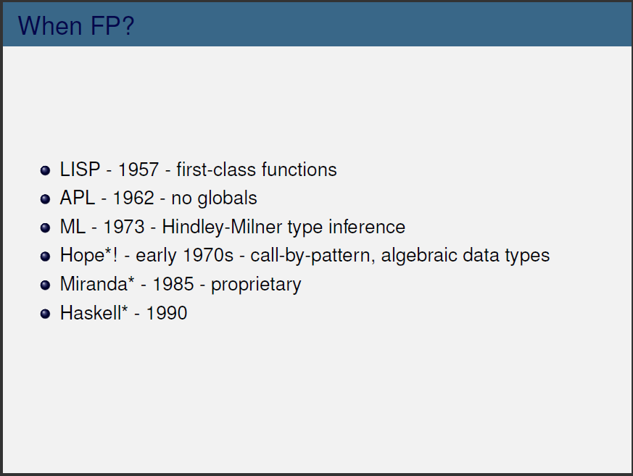
Only predated by FORTRAN

Slide 51
History
Overview
Paradigm
Environment
Language Intro
Lab #3

Slide 52

History: Erlang
Proprietary language used at Ericsson, developed by Joe Armstrong
Initially implemented in Prolog at Ericsson
By 1988, it had been proven suitable for prototyping telephone exchanges but…
Prolog interpreter was much too slow, needed to be 40x faster.
In 1992 work began on BEAM VM
Compiles Erlang to C
Balance between performance and disk space.
Went from lab product to real applications by 1995
In 1998, Ericsson banned internal use of Erlang, causing Armstrong to quit.
Rehired in 2004, after ban was lifted.

Slide 53


History: Elixir
Builds on Erlang, runs on BEAM VM
Erlang was prolog-like, Elixir is more conventional.
First appeared in 2011
Developed by Jose Valim as an R&D project at Plataformatec (consulting firm)
Used at Pinterest, and for web development by Discord.

Slide 54
Elixir Overview
Elixir is a functional programming language
Mostly immutable, rich support for concurrency
Everything is an expression.
Remember Smalltalk, everything is an object.
Elixir compiles into Erlang bytecode.
Thus, Erlang functions can be called from Elixir
Emphasizes recursion and higher-order functions
As opposed to side-effect based looping

Slide 55
Elixir Processes
Elixir code runs inside lightweight threads of execution.
Isolated, exchange information via message passing.
Not uncommon to have hundreds of thousands of processes running concurrently in same VM.
Note: These are NOT operating system processes!
Extremely lightweight in terms of CPU and memory
A process need not be an expensive resource

Slide 56
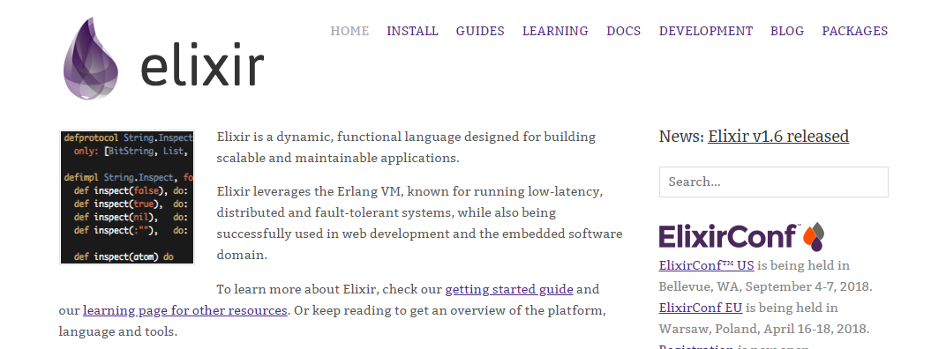
Installing Elixir
https://elixir-lang.org/

Slide 57
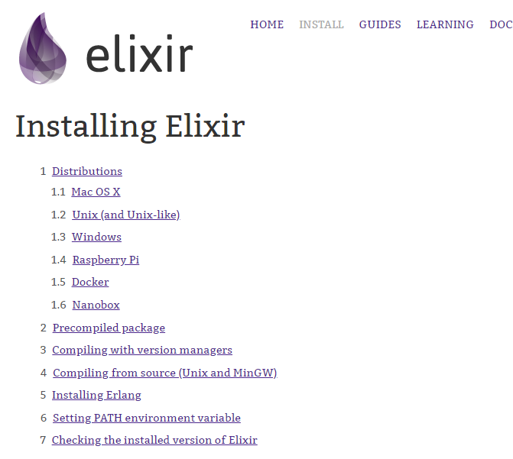
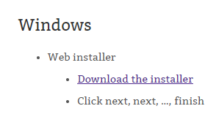
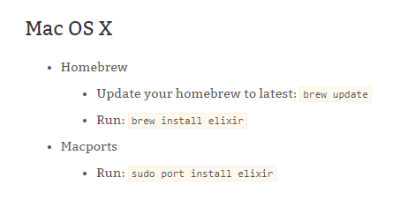

Slide 58
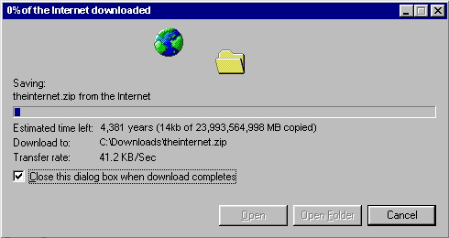

Slide 59
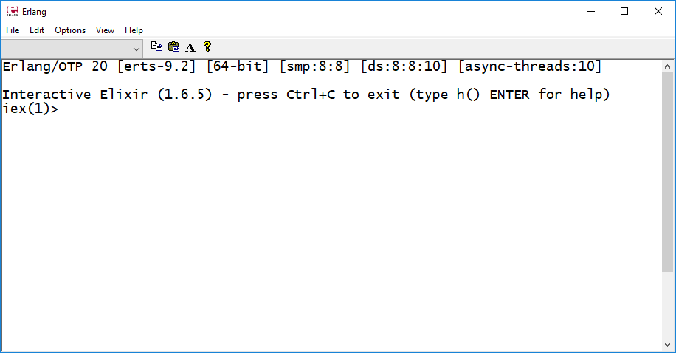
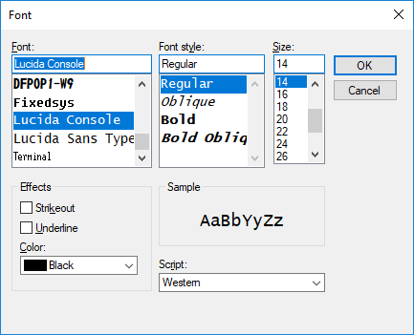
Erlang Shell
Better than just a terminal window

Slide 60
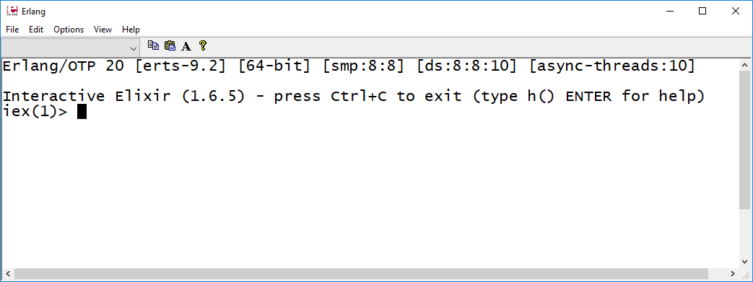
Writing and Compiling Elixir
Play around in the interactive shell, or do things from the command line.
IDEs exist, but you’re on your own. I won’t help troubleshoot IDE-related problems.
This is the Erlang shell. We can:
Type code into here line by line
Copy and paste code into here large chunks at a time
Define modules and functions – though it’s tedious.

Slide 61
Elixir References:
https://media.pragprog.com/titles/elixir/ElixirCheat.pdf
https://elixir-lang.org/getting-started/introduction.html
https://hexdocs.pm/elixir/master/api-reference.html#content

Slide 62
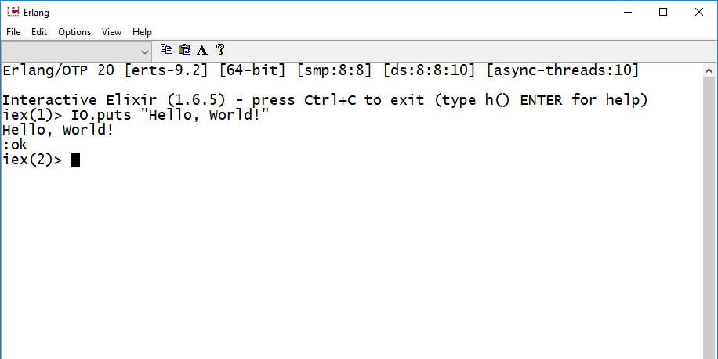
Hello World
IO.puts “Hello, World!”
IO.puts prints to the shell
When executing in the shell, return values get echoed.
In this case, IO.puts returns the atom :ok
Atoms in Elixir are similar in concept to symbols in Smalltalk.

Slide 63
Hello World
IO.puts “Hello, World!”
We will start in this shell for basic concepts. Later, we will see how to run scripts and compile code from the command line (It’s not so bad)

Slide 64
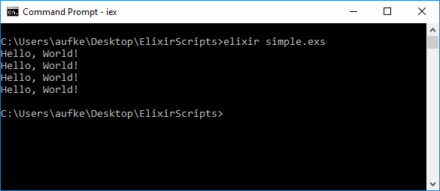
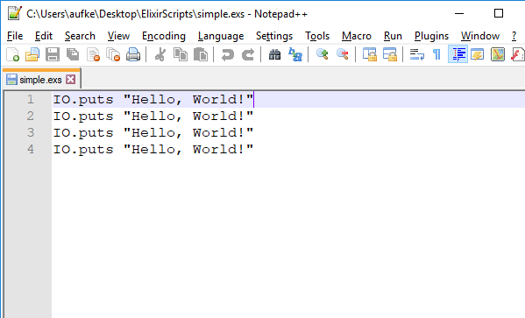
Elixir Scripts

Slide 65
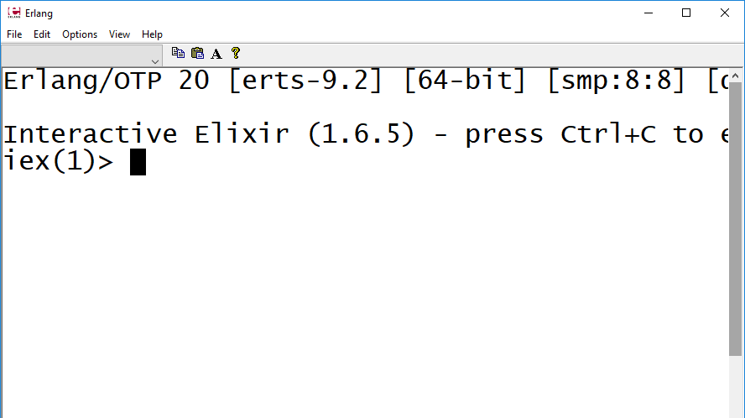


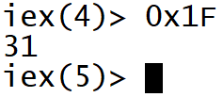
Elixir Syntax: Basic Types
Typing literals into the shell will echo them back, assuming they are valid.
Decimal, binary, octal, and hexadecimal integers

Slide 66
Elixir Syntax: Basic Types
Typing literals into the shell will echo them back, assuming they are valid.
More accurately:
Everything in Elixir is an expression, even single literals.
Evaluating a literal simply returns that value.
In the interactive shell, the return value is printed for us.
:ok is the return value of IO.puts. The actual printing to the screen is a side effect!

Slide 67
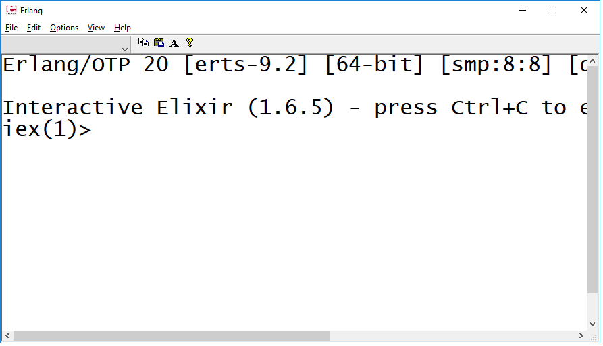


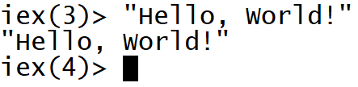
Elixir Syntax: Basic Types
Floating point, Boolean, strings

Slide 68
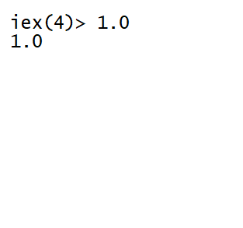




Floating Point
Floats in Elixir are 64-bit, double precision
Elixir supports scientific notation
Rounding and truncate functions

Slide 69
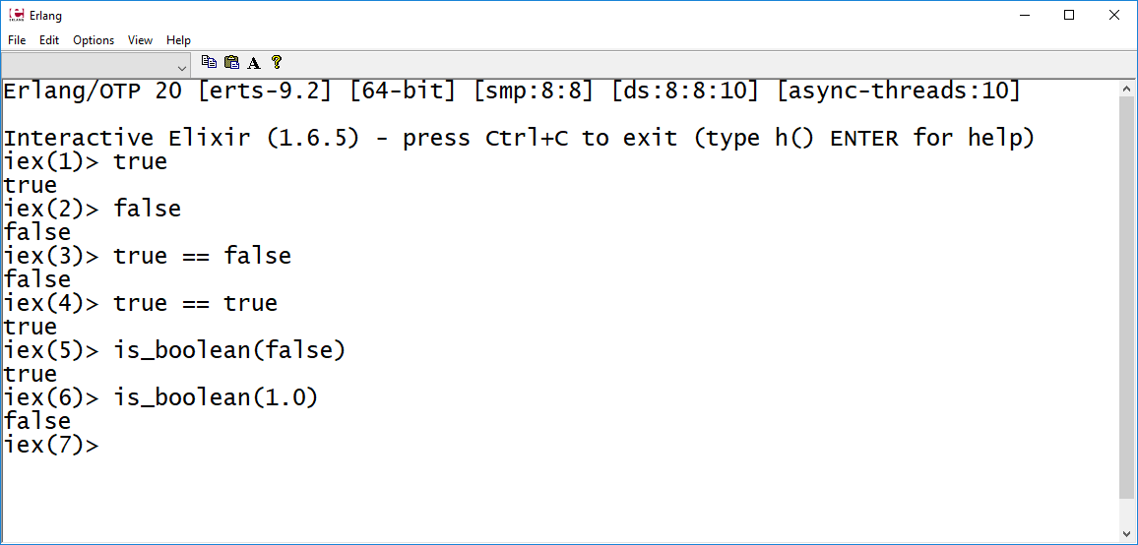
Boolean
Comparison operator works the way we’re used to
We can check if a value is Boolean using the is_boolean function

Slide 70
Types, Values, Truthiness
In Elixir we have Boolean values true and false.
Not all languages have a Boolean type.
C does not have a Boolean type. It still supports Boolean expressions, of course.
In C, numeric 0 is considered False, and everything else is considered True.
In Java, we have Boolean. Logical operators are only valid with Boolean operands.
Elixir complicates things by combining both approaches:
We have Boolean True and False, but values of every other type are considered either true or false.

Slide 71
Boolean Expressions
With these operators:
non-false and non-nil are true.
nil and false are false.
0 is considered true!
Boolean:
true, false
&&, ||, !
iex> "gh" && false
false
iex> "gh" || false
"gh"
Except…
The result isn’t true or false
It’s the value that decided the result of true or false
What we actually get is the value that determined the truthiness of the expression

Slide 72
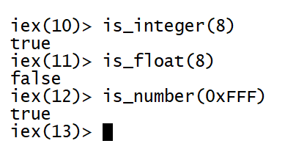
Test Type
Elixir is dynamically typed!
Type errors occur at run-time, not at compile time.
I.e., attempting some operation on incompatible types results in a run-time error.
A static type system catches type errors at compile time

Slide 73
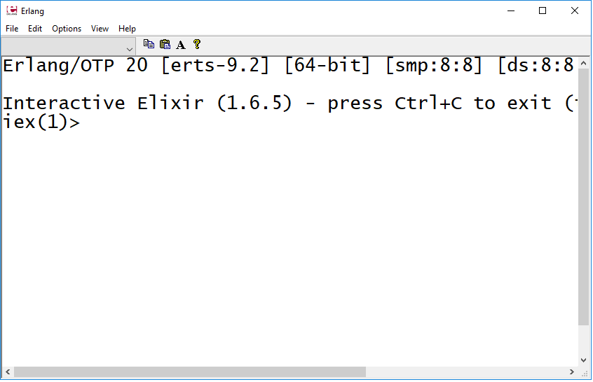


Basic Arithmetic
Addition, multiplication
Division:
Notice 5.0, despite integer operands
/ operator returns float in Elixir

Slide 74
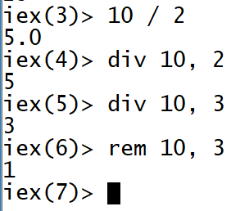
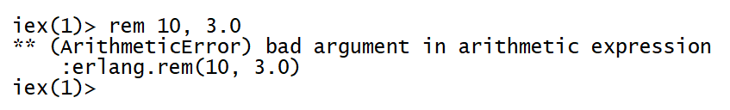
Basic Arithmetic
div and rem operators
div:
Result of integer division
Like / in Java
rem:
Remainder operator
Same as % in C
Requires integer arguments

Slide 75
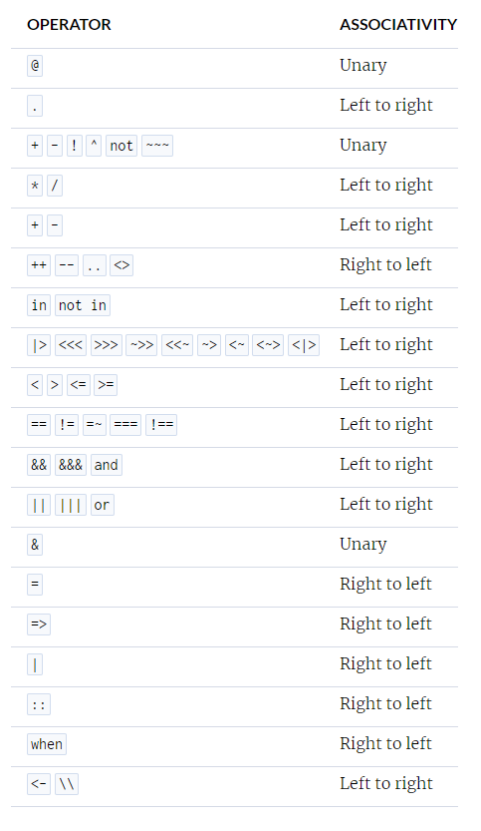
Precedence?
It’s fairly typical:
https://hexdocs.pm/elixir/master/operators.html

Slide 76
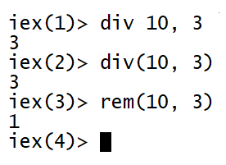
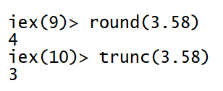
div and rem are functions:
Elixir allows us to drop the brackets
Likewise for round and trunc and is_boolean

Slide 77
Functions
?
Elixir functions are described in terms of their name and arity
Arity refers to the number of arguments a function takes
Elixir functions are commonly described by the following notation: name/arity
round/1
rem/2
trunc/1
div/2
is_boolean/1
This is not language syntax, just a documentation style.

Slide 78
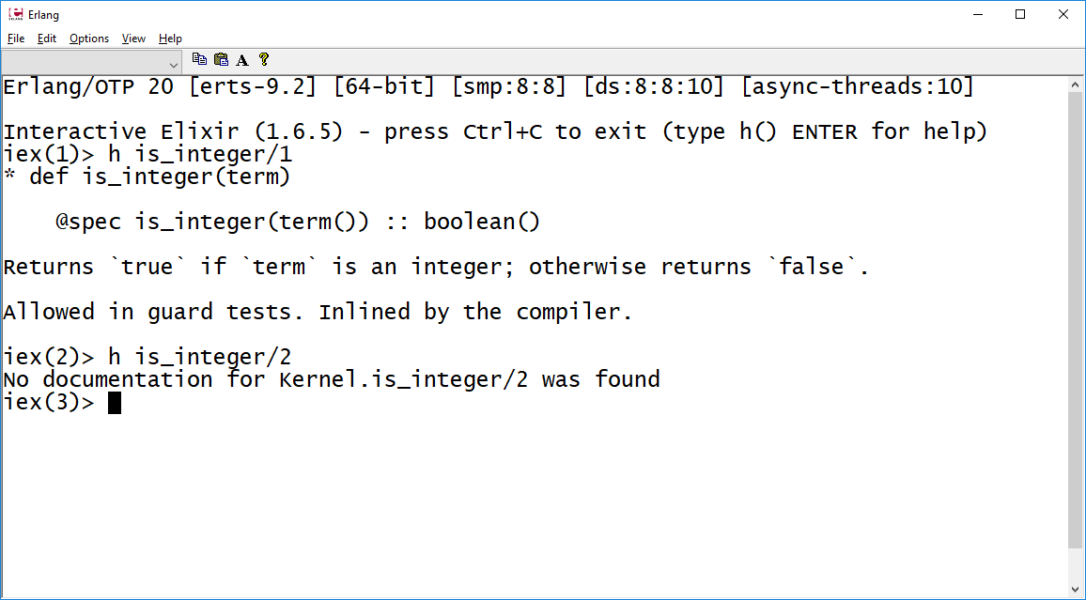
Getting Help:

Slide 79
More Types: Atoms
Atoms:
A constant whose name is its value:
iex> :hello
:hello
iex> :world
:world
iex> :hello == :world
false
Boolean literals are Atoms:
iex> :true == true
true
iex> :false == false
true
iex> is_boolean(:false)
true
Elixir atoms are the equivalent of Smalltalk symbols.
Equal atoms exist only once in memory.

Slide 80
More Types: Strings
Can have line breaks in them:
We can use IO.puts/1 to print a string:
iex> "Hello,
...> World!"
"Hello,\nWorld!"
iex> "Hello,\nWorld"
"Hello,\nWorld"
iex> IO.puts "Hello\nWorld!"
Hello
World!
:ok
Newline is evaluated when we use the puts function.
IO.puts/1 returns the atom :ok after printing

Slide 81
More Types: Strings
Unicode: length VS number of bytes
Strings in Elixir are represented by sequences of bytes.
iex> byte_size "Hello"
5
iex> byte_size "Hellö"
6
iex> String.length "Hellö"
5
However. Unicode characters beyond 255 require two bytes to represent:
Use String.length/1 to find the number of characters.

Slide 82
More Types: Strings
Interpolation, concatenation
iex> name = "Alex"
"Alex"
iex> "Hello, #{name}!"
"Hello, Alex!"
iex> name = "Alex"
"Alex"
iex> "Hello, " <> name
"Hello, Alex"
Interpolation
Concatenation

Slide 83
Collections: Lists
Use [ ] to define a list of values.
Like Smalltalk, values can be anything (heterogeneous).
Lists operations are central in functional languages
iex> [1, 2, true, 3, false]
[1, 2, true, 3, false]
iex> length [1, 2, 3]
3
Use length/1 to print the number of values in the list.
Lists are implemented in Elixir as linked lists.

Slide 84

Lists are implemented in Elixir as linked lists.
Heads
Tails
iex> list = [1, 3.14, true, "Hello", :World]
[1, 3.14, true, "Hello", :World]
iex> hd list
1
iex> tl list
[3.14, true, "Hello", :World]
Return first element of list
Return all but first element of a list

Slide 85
Lists are implemented in Elixir as linked lists.
Heads
Tails
iex(30)> hd [1]
1
iex(31)> tl [1]
[]

Slide 86
List Concatenation & Subtraction
iex> list = [1, 2, true, :Hello, "World", false, 5]
[1, 2, true, :Hello, "World", false, 5]
iex> list -- [true, false]
[1, 2, :Hello, "World", 5]
iex> list ++ [6]
[1, 2, true, :Hello, "World", false, 5, 6]
iex> list -- [:Hello, "abcd"]
[1, 2, true, "World", false, 5]
Safe to subtract a missing value!

Slide 87
Huh?
iex> [104, 101, 108, 108, 111]
'hello'
When the Erlang shell sees a list of printable ASCII numbers, it displays them as a list of characters.

Slide 88
Collections: Tuples
A sequence of values whose elements are stored contiguously in memory
iex> tup = {1, "2", :three}
{1, "2", :three}
iex> elem tup, 0
1
iex> elem tup, 1
"2"
iex> elem tup, 2
:three
iex> elem tup, 3
** (ArgumentError) argument error
:erlang.element(4, {1, "2", :three})
This means we can directly access individual elements using elem/2:

Slide 89
Lists & Tuples are Immutable
Operations result in new lists/tuples:
iex> tup
{1, "2", :three}
iex> put_elem(tuple, 1, 55)
put_elem/3 to change an element
{1, 55, :three}
iex> tup
{1, "2", :three}
put_elem/3 returned a different tuple. The original hasn’t changed.
Bind a new label (or re-bind tuple) to save the result.
tup = put_elem(tuple, 1, 55)

Slide 90
Elixir Variables are Immutable
When we say: x=1
The value 1 is created in memory
x is a label for the value 1
If we then say: x=2
We are NOT changing the value 1 in memory.
We are creating the value 2 at a different place in memory
x is now a label for the value 2
This is called re-binding.
We change the label, not the value.

Slide 91
Elixir Variables are Immutable
x = 1
x = 2
1
2
x

Slide 92

Elixir Variables are Immutable
x = 1
x = 2
1
2
x
Garbage:

Slide 93
Elixir Variables are Immutable
In imperative languages, variables can be thought of as containers.
We can put whatever we want into the container (as long as the type system allows it, of course)
Reassigning a variable means mutating the value in the container
In Elixir and other functional languages, variables are labels.
We can change the value that we apply the label to, but we can’t change the value itself.

Slide 94
Lists or Tuples?
Lists in Elixir are linked lists:
Linear time to access and append, constant time to pre-pend
Use to store a collection of values
Tuples are contiguous:
Constant time to access, linear time to update
Use when size and contents are fixed at compile time.
Not meant to be iterated over, direct element access only.
Both are immutable, updating creates new list/tuple. However:
If we change one element in a 10-element tuple, we don’t actually duplicate values for the 9 unchanged elements.
Behind the scenes, elements can be shared.

Slide 95
Lists or Tuples?
Appending to a list is costly, prepending is cheap
There’s a technical reason for this related to how lists are represented internally.
We need to learn a bit more before we can explain it more precisely.
In concept, imagine a linked list without a reference to the last element.
Adding to the front is constant time, adding to the end requires a linear-time traversal of the entire list.

Slide 96
Type Summary
Integer:
2, -7, 0x1F, 0o777, 0b10101
+, -, *, /
div/2, rem/2
>, >=, <, <=, ==, !=
Float:
2.0, 1.1e-3, 3.14e7
Boolean:
true, false
Atom:
:Hello, :world, :false, :true
String:
“Hello, World!”, “123”, “tr\nue”
Concatenation <>, interpolation #{}

Slide 97
Type Summary
Lists
[ ], [1, 2, 3], [1, 2.0, “three”, :Four]
Stored as linked lists in memory
Tuple:
{ }, {1, 2, 3}, {1, 2.0, “three”, :Four}
Stored contiguously in memory
Both heterogeneous, both immutable

Slide 98
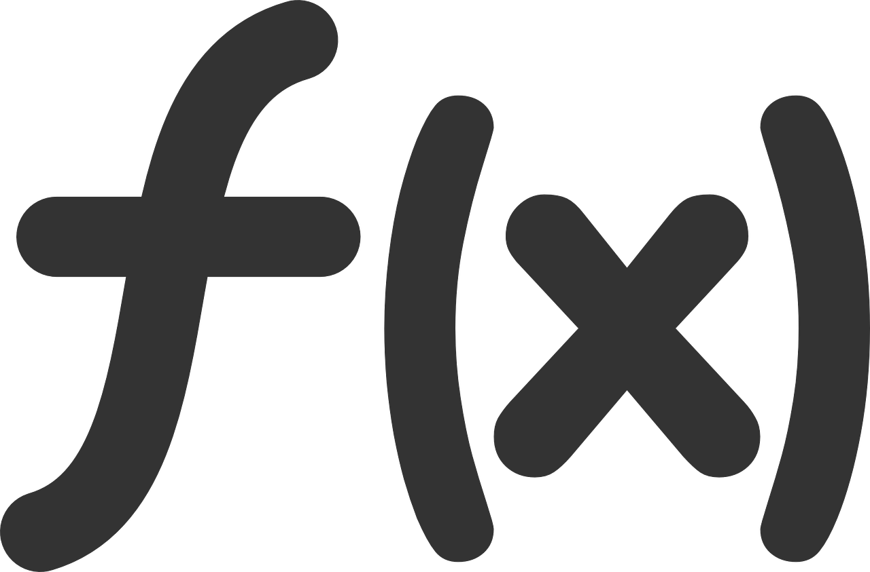
Functions

Slide 99
Named Functions
Defined within a module
Modules can contain multiple functions
Modules can be compiled independently, making functions available for later use.
Named functions are not first class!
Cannot be passed as arguments, cannot be returned
Named functions of same name can have different arity, unlike anonymous functions (coming up)

Slide 100
Modules and Named Functions
Module name:
Function name and argument list
defmodule Greeter do
def hello(name) do
"Hello, " <> name
end
end
Function expressions

Slide 101
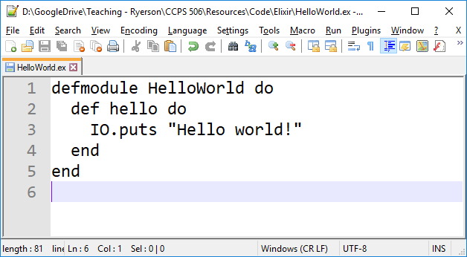
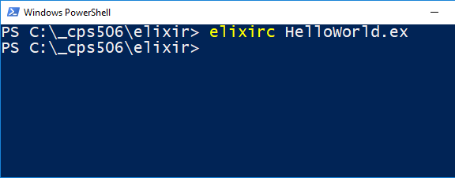
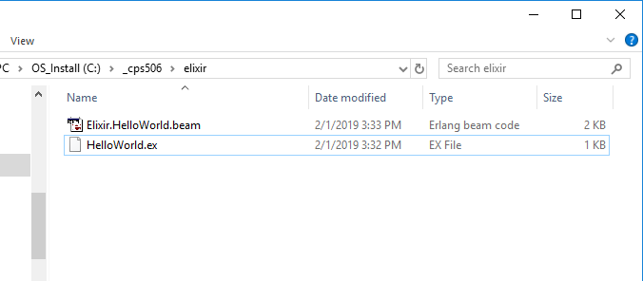
Erlang bytecode

Slide 102



In a script file (.exs)

Slide 103


Named Functions
Named functions (and modules) can be defined in a script, but then we can’t use them later (without including their source code)

Slide 104



Named functions (and modules) can be defined in a script, but then we can’t use them later (without including their source code)
Define Greeter module in the file “Greeter.ex”
Compile it with elixerc:

Slide 105


As long as the script is in the same folder, we can invoke functions from Greeter:

Slide 106
Return Values
We don’t have an imperative-style return statement in Elixir
The evaluation of the final expression is returned.
defmodule Silly do
def print() do
"Hello"
","
" "
"World!"
end
end
IO.puts Silly.print()
Four expressions
World!

Slide 107



“Overloading”

Slide 108



Multiple Modules

Slide 109
Anonymous Functions
Can be created live, inline:
Delimited by fn and end keywords
iex> add = fn a, b -> a + b end
Anonymous functions can be assigned to a variable.
They are first class
Can be passed to another function and invoked there.
Function arguments
Function behavior

Slide 110
Anonymous Functions
Invoke using the dot operator:
iex> add = fn (a, b) -> a + b end
#Function<12.99386804/2 in :erl_eval.expr/5>
iex> add.(1, 2)
3
iex> add.(8, 9)
17
Arguments are passed in the usual manner
Can’t use this syntax with anonymous functions:
iex> add 8, 9
** (CompileError) iex:8: undefined function add/2

Slide 111
Shorthand
iex> add = &(&1 + &2)
&:erlang.+/2
iex> add.(3, 4)
7
iex> add.(8, -4)
4

Slide 112


Function Composition
(Maybe) not the most readable

Slide 113
Function Composition
The pipe operator:
x = inc.(inc.(inc.(inc.(0))))
Can be written as:
x = 0 |> inc.() |> inc.() |> inc.() |> inc.()
Results just cascade into each other.

Slide 114
Summary:
Functional programming paradigm
The Erlang VM
Intro to Elixir programming language
Basic types, strings, lists, tuples
Named and anonymous functions

Slide 115

Next Week:
Pattern Matching

